Slide 1
Module 4 Materialized View Processing and Design
Lesson 2: Materialized view definition and processing
Notes:
Welcome to Lesson 2 of Module 4 on Materialized View Processing and Design
Opening question
- What are roles of optimizing SQL compilers in materialized view processing?

Slide 2
Lesson Objectives
Write statements to create materialized views
Explain processing requirements for materialized views
Reflect on the complexity of materialized view processing
Notes:
Lesson 2 presents an overview about materialized view definition, processing, and design.

Slide 3
Comparison of Traditional and Materialized Views
Traditional views
Derived when used
Simplification
Materialized views
Stored and periodically refreshed
Performance improvements
Invisible
Visible
Simple processing
Substantial processing
Notes:
Stored views
Creation options: on demand or periodically
Can index and use auxiliary storage methods
Possible to refresh
Preprocess some parts of data intensive queries
Performance improvement motivation
Not visible to business analysts
Query rewriting process to reduce resource requirements of data intensive queries
Physical design tools to determine best set of materialized views
Refreshment support to determine refresh period and method (incremental or full)
Lots of research and development by commercial DBMS vendors

Slide 4
Materialized View Example
Sum of dollar sales after 2010 by store state and year
Mapping with a SELECT statement
Materialization properties
Storage options
CREATE MATERIALIZED VIEW MV1
BUILD IMMEDIATE
REFRESH COMPLETE ON DEMAND
ENABLE QUERY REWRITE AS
SELECT StoreState, TimeYear,
SUM(SalesDollar) AS SUMDollar1
FROM SSSales, SSStore, SSTimeDim
WHERE SSSales.StoreId = SSStore.StoreId
AND SSSales.TimeNo = SSTimeDim.TimeNo
AND TimeYear > 2010
GROUP BY StoreState, TimeYear;
Notes:
Materialization
Build: immediate or deferred
Refresh: fast or complete; restrictions on fast refresh
No storage options shown. Can you most options available with a table.
Mapping
Typically joins and grouping with aggregate calculations
Sometimes just joins
Specification of a materialized view in Oracle involves elements of base table specification and the mapping specification of traditional views along with specification of materialization properties. Since a materialized view is stored, most of the storage properties for base tables can also be specified for materialized views. Since the storage properties are not the focus here, they will not be depicted. The mapping specification is the same for views as materialized views. A SELECT statement provides the mapping necessary to populate a materialized view. The materialization properties include the method of refresh (incremental or complete), the timing of refresh (on demand or on commit), and the build timing (immediate or deferred). Oracle has a number of restrictions on the types of materialized views that can be incrementally refreshed so incremental refreshment will not be discussed here.

Slide 5
Materialized View Processing
Rewrite
Refresh
Match query to MVs
Evaluate rewritten query
Specify workload
Search large space
Evaluate choices
Frequency
Method
Design
Notes:
Complex processing
Major advantage for DBMS vendor with lots of R/D on optimizing database compiler
Matching process
More difficult than query modification
Optimizer evaluates rewritten queries
Strong incentive to reduce space of rewritten queries
MV selection
Workload specification
Large space: number of queries and rewriting possibilities
More difficult than index selection problem
Can index MVs for another complexity
Requires usage of optimizer to evaluate MVs
Refreshment:
https://docs.oracle.com/database/121/DWHSG/refresh.htm#DWHSG9081
Period: usually part of refresh but can be done more frequently
Method: incremental or complete
Query rewriting and optimization
Matching query to materialized views
Optimizer evaluates rewritten queries
MV design
Specify workload
Search large space of possible MVs
Apply query rewriting/optimization to evaluate choices
Refreshment of materialized views
Frequency
Method

Slide 6
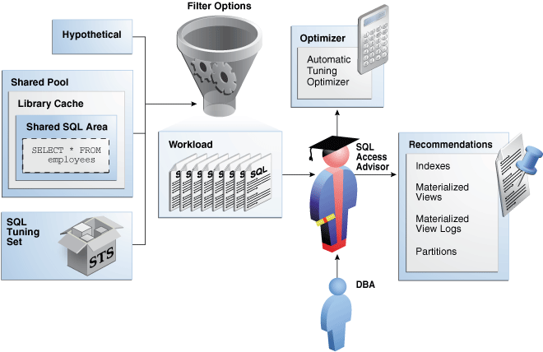
Oracle SQL Access Advisor
Notes:
Oracle SQL Access Advisor
https://docs.oracle.com/database/121/TGSQL/tgsql_sqlaccess.htm#TGSQL94778
Source: Oracle® Database SQL Tuning Guide Chapter 21
Input
Shared SQL area: recent SQL statements
SQL tuning set: database object for workloads; SQL statements and execution context (frequency, time)
Hypothetical workload: used when no workload exists or to extend workload with anticipated statements
Filters: select statements from workload such as most frequently executed
Filters
Resource consumption: number of high load statements ordered by cost, memory usage, CPU time, disk reads, …
Tables or columns
Users
Recommendations
Materialized views
Indexes for MVs
Logs for MVs to enable fast refresh
Partitions: for base tables and MVs
Automatic Tuning Advisor

Slide 7
Usages of the SQL Access Advisor
Design choices
Choose materialized views, indexes, and partitions
Advice
Make a materialized view fast refreshable
Change a materialized view so that query rewrite is possible
Manage workloads and recommendations

Slide 8
Workload Specification
Collected from executed SQL statements using the Automatic Workload Repository
SQL statement
Number of executions
Resource consumption (CPU time, disk reads, and optimizer cost)
Rows retrieved
Priority
Filter by resource consumption, priority, users, and columns
Notes:
Priority: high, medium, or low
To support workload collection, Oracle provides a workload database known as the Automatic Workload Repository (AWR). The AWR contains execution history of SQL statements including the statement text, CPU time, elapsed time, disk read, rows retrieved, and frequency. The AWR is populated by periodic snapshots of database operations. By default, Oracle automatically generates snapshots of database operations once every hour and retains the statistics in the workload repository for eight days. A database designer can modify the default snapshot interval as well as create snapshots manually.

Slide 9
Additional Problems
MV2
USA store sales by store state, year, and month
Sum of dollar sales
MV3
Canadian store sales before 2011 by store city, year, and month
Sum of dollar sales
Other options
Build immediate
Refresh complete
Enable query rewrite

Slide 10
Summary
Stored, derived data for improved query performance
Complex processing
Major DBMS innovations
Notes:
MVs for summary data storage and reuse
Traditional views for simplification and security (convenient unit of security)
Rewriting process involves matching process and optimization process. Much more complex than substitution process for using traditional relational views.
Practice matching process to gain insights about the complexity of query rewriting
DBMS innovations
Rewriting process
Design tools for determining best collection of MVs
MV indexing
Design decisions very complex
Assignment covers materialized view definition and query rewriting
Query rewriting part of assignment will help you understand the matching process and underlying complexity.

